Slide 1
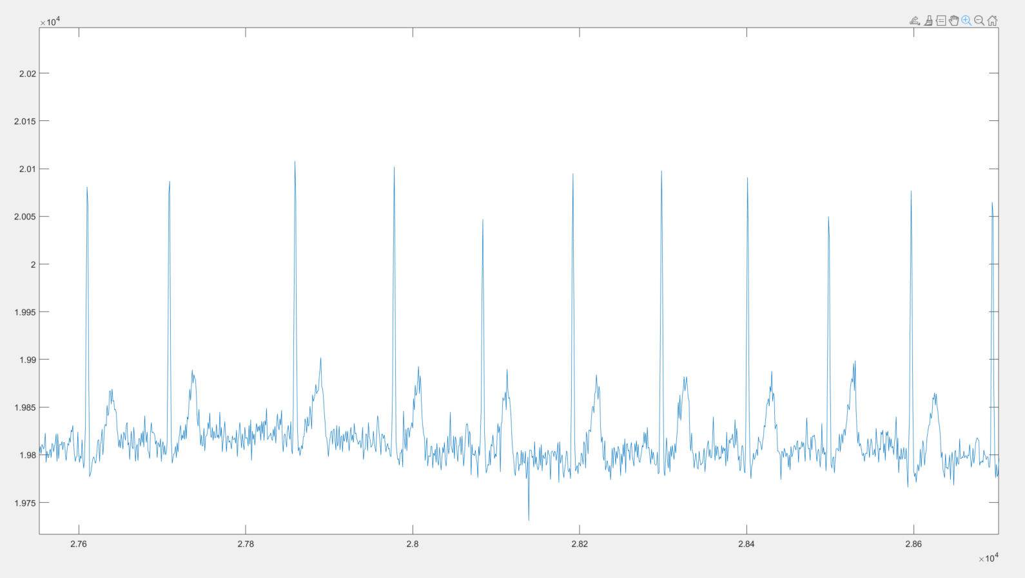
Watch Peaks
Holter Peaks
FP
FN
FN
FN
FP
FP

